Slide 1

Impact of Brexit on Major Western European Economies

Slide 2
What is Brexit?
Name given to UK’s departure from EU
Only nation to have left the EU
Grew out of “Euroscepticism”
Vote was held as part of campaign promise made by Conservative PM David Cameron
Divisive internally, political drama

Slide 3
Why is it important?
Brexit presents multiple shocks that can be analyzed
Predicted economic outcomes
Harm UK economy
Reduce UK real per capita income (long term)
Referendum itself damaged the economy
Large decline in immigration from European Economic Area (EEA)
Poses problems for British higher ed and academic research
Should be studied by nations or entities looking to separate from a union (Scotland/UK, Texas/US)

Slide 4
Significant Dates - Timeline
6/23/16 - UK citizens voted to leave EU
Prime Minister David Cameron and other high-ranking officials resign in the coming days
3/29/17 - EU Council President Donald Tusk given letter from UK Prime Minister Theresa May to begin two-year process of EU withdrawal
Brexit negotiations proceeded on June 19th
7/9/18 - Boris Johnson resigns as foreign secretary
7/24/19 - Theresa May resigns as Prime Minister, Boris Johnson becomes PM
12/31/20 - As of 11 PM GMT, UK is no longer in EU.
Five event dummies created, plus one covid dummy

Slide 5
Existing Studies
Most existing research focused on effects of Brexit on UK
2017 study suggests that even six months after the vote, UK had no discernable macroeconomic effects, besides pound (GBP) devaluation (Johnson, Mitchell)
Another 2017 study suggests how lack of freedom of movement could decrease EU funding and students at UK universities (Mayhew)
Our study looks at Brexit effects on other major European economies
BBC - German imports from UK down 56% from Jan 2020 and Jan 2021 (3/10/21)
BBC - UK to be dropped from Germany’s top 10 trading partners (9/9/21)

Slide 6
Data Collection
We collected our data from investing.com
Selected the FTSE index, DAX index, and CAC 40
Selected data from July 2015-December 2021
Selected dummy duration to be two weekdays before event and five weekdays after
Anticipation and effect
For events lasting multiple days, the same before/after duration was selected
COVID lasts from first major restrictions to most recent “opening up”

Slide 7
Methodology and Model
Goal : Study the effect of Brexit events on France and Germany stock markets.
Methodology : VAR model.
Model Parameters:
- Use of stationery variables i.e returns data. Econometrics tools used to confirm stationarity are correlograms to see if everything was in 2 S.D. and unit root tests
- Additionally, Conitegration Test, and Granger Causality

Slide 8
Unit Root Test Results
Since in every case, the computed t-statistics is left of the significance level, we are able to reject the null hypothesis that the returns data is non-stationary.
VARIABLE | TEST | 5% SIGNIFICANCE | T-STATISTICS | Result
Ret. France | Unit Root test | -2.863114 | -40.04298 | Stationary
Ret. UK | Unit Root test | -2.863114 | -41.10792 | Stationary
Ret. Germany | Unit Root test | -2.863114 | -40.54432 | Stationary

Slide 9
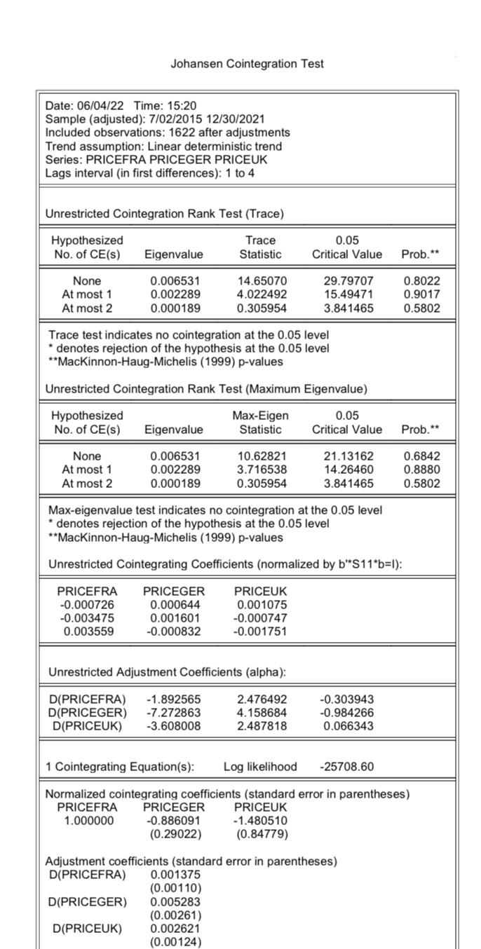
Johansen Cointegration Test
None of the level are statistically significant
Trace statistic is larger than the critical value at all levels
High p value at all levels
We fail to reject the null hypothesis that there is no cointegration
Can assume markets are not cointegrated

Slide 10
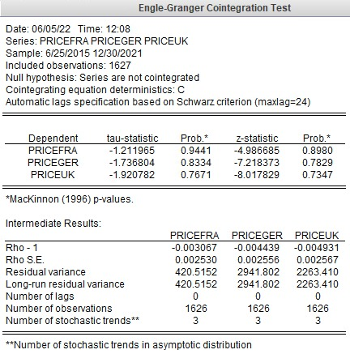
Engle-Granger Cointegration Test
None of the countries are statistically significant
High p values for all the countries ( > 0.05)
We fail to reject the null hypothesis that there is no cointegration
Can assume markets are not cointegrated

Slide 11
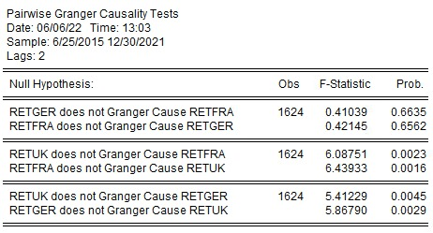
Granger Causality
Fail to reject null for Germany/France interaction
This implies the ordering of the economies:
France -1st
UK - 2nd
Germany - 3rd
Doesn’t make sense intuitively, as size of economies is different
Germany - 1st
France - 2nd
UK - 3rd

Slide 12
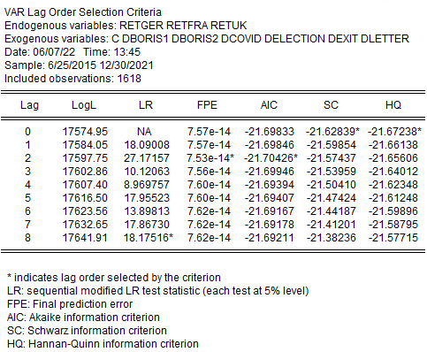
VAR Model
We know that VAR+EC=VEC.
Since markets not cointegrated, error correction mechanism
with non-stationary variables is not needed.
Therefore we estimate a VAR model with stationary variables.
We can see from the lag length criterion suggests 2 lags are
sufficient for us in order to re-estimate the VAR model.

Slide 13
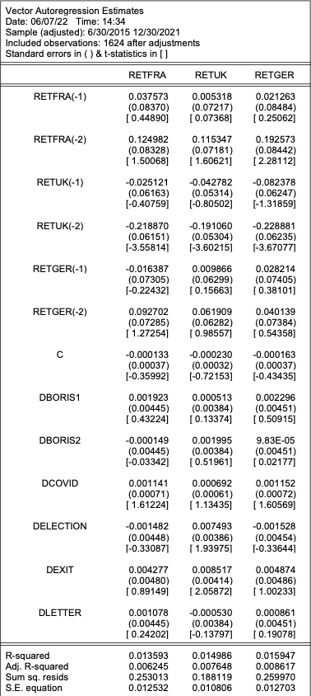
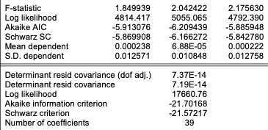
VAR Model 1 - Ordering by the
granger causality results.
We estimate a VAR model with stationary variables with 2 lags.
France - Significant for 2nd UK lag,
not significant for dummy variables
UK - Significance for 2nd UK lag term and exit dummy variable
Germany - Significance for 2nd France and UK lag terms,
no significance for any dummy variables
Overall low Adjusted R-squareds

Slide 14
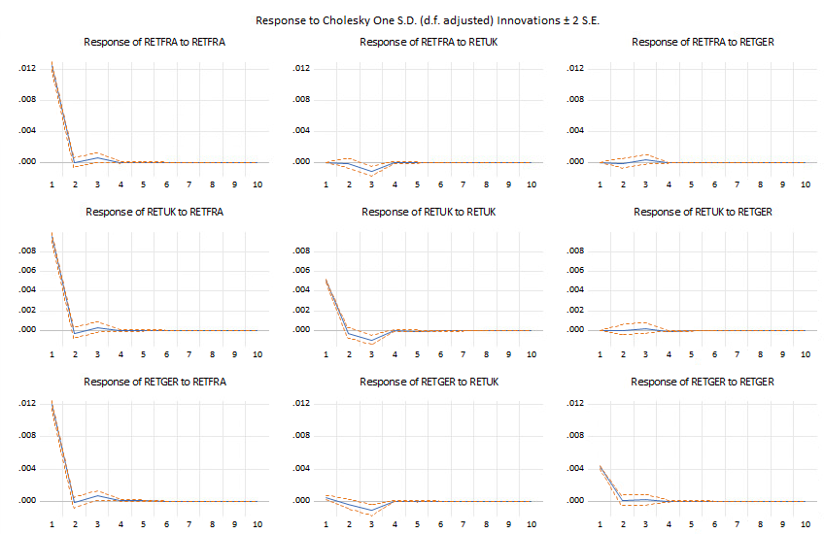
Impulse Response - VAR 1
- 1 S.D.(0.012%) change in france
returns affect UK returns in the
same day by 0.008% and retger
by 0.0012%
- Similarly, we can see that
a 1 S.D.(0.005%) change in UK
returns has very minimal impact
on returns of france and germany
on the same day i.e within 2 S.D.
- Also, 1 S.D.(0.004%) change in
germany returns has very minimal
impact on returns of france and uk
on the same day.

Slide 15
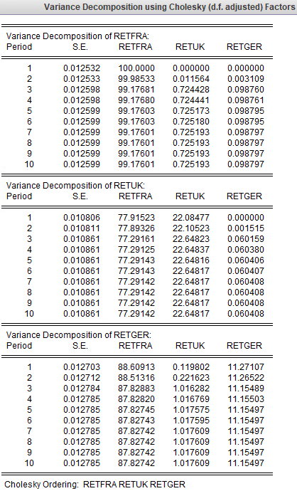
Variance Decomposition - VAR 1
About 99% of the variation in RETFRA is explained by itself.
Only about 0.72% of the variation in RETFRA is explained by RETUK
Only about 0.098% of the variation in RETFRA is explained by RETGER
About 77% of the variation in RETUK is explained by RETFRA
About 22% of the variation in RETUK is explained by itself
Only 0.06% of the variation in RETUK is explained by RETGER
About 88% of the variation in RETGER is explained by RETFRA
About 1% of the variation in RETGER is explained by RETUK
About 11% of the variation in RETGER is explained by itself

Slide 16
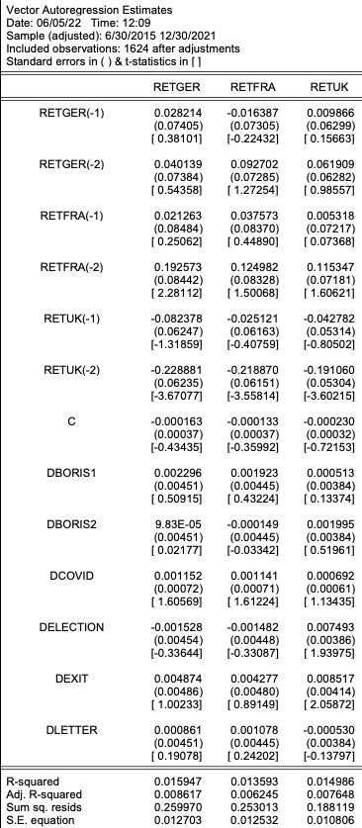
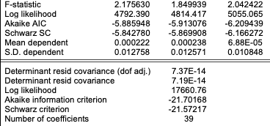
VAR Model 2 - Ordering by size
of economy.
Since the granger causality test was counterintuitive when compared with
the size of the economies, we ran a second VAR model with ordering of
Variables as per the size of the economies.
We estimate a VAR model with stationary variables with 2 lags.
Germany - Significance for 2nd France and UK lag terms no statistical significance for dummy variables
France - Significance for 2nd UK lag
no significance for dummy variables
UK - Significance for 2nd UK lag and exit dummy variable
Overall low Adjusted R-squareds

Slide 17
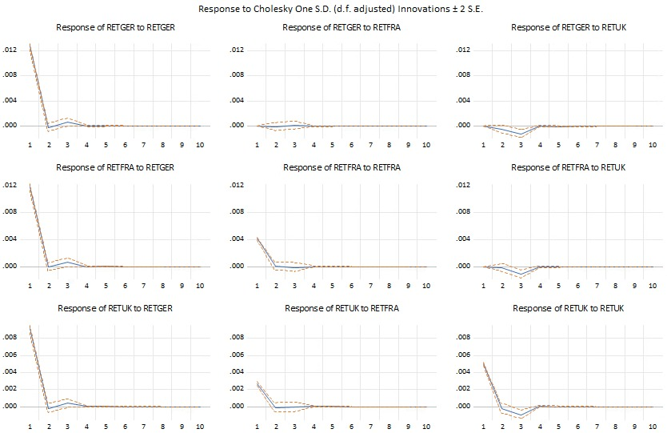
Impulse Response - VAR 2
- 1 S.D.(0.012%) change in germany returns
affect UK returns in the same day by 0.008%
and france returns by 0.0012%
- Similarly, we can see that a 1 S.D.(0.005%)
change in UK returns has very minimal
impact on returns of france and germany
on the same day i.e within 2 S.D.
- Also, 1 S.D.(0.004%) change in france
returns has very minimal impact on returns
of france and uk on the same day.

Slide 18
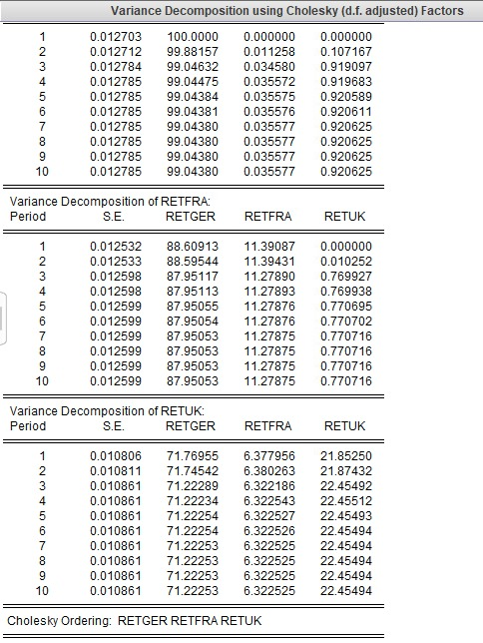
Variance Decomposition - VAR 2
- About 99% of the variation in RETGER is explained by itself.
- Only about 0.035% of the variation in RETGER is explained by RETFRA
- Only about 0.92% of the variation in RETGER is explained by RETUK
- About 88% of the variation in RETFRA is explained by RETGER
- About 11% of the variation in RETFRA is explained by itself
- Only 0.77% of the variation in RETFRA is explained by RETUK
- About 71% of the variation in RETUK is explained by RETGER
- About 6% of the variation in RETUK is explained by RETFRA
- About 22% of the variation in RETUK is explained by itself

Slide 19
Conclusion
Difficult to discern effects of UK events on French and German stock market, if any at all
Model could be improved
Additional national stock market regressors (Italy, Spain, etc)
National event dummies
Additional explanatory variables (investor confidence, per capita GDP, etc)
Our overarching question has yet to be answered - this may require more data, and thus more time observing these effects

Slide 20
References
https://www.investing.com/
https://academic.oup.com/oxrep/article-abstract/33/suppl_1/S12/3066083?redirectedFrom=fulltext&login=false
https://academic.oup.com/oxrep/article-abstract/33/suppl_1/S155/3066079?redirectedFrom=fulltext&login=false
https://www.bbc.com/news/56347096
https://www.bbc.com/news/business-58484454

